Slide 1


ShipSmart Software
Created For Patco Shipping and Logistic Company
By Software Chasers :
Heba Shubib
Sagina Athikkal
Pragati Gupta
Tejaswi Kukulakanta
Supervised By:
Dr. Hubert A. Johnson
CSIT 515 Software Engineering & Reliability
05/17/2021

Slide 2

What is ShipSmart?
Shipping Software
Tracking Tool
Management Tool
dd

Slide 3
Purpose of ShipSmart
ShipSmart was built to meet Patco’s specific needs for domestic and cross-border logistics.
Creates user friendly website for Patco clients, allows users to create profiles and create/manage their shipments
Help Patco employees to manage orders, claims, bills and accounting
dd

Slide 4
Requirements Elicitation
Functional Requirements
Non Functional Requirements
dd

Slide 5
Functional Requirements
Book Shipment Online | Admins and Clients Can book shipment and schedule pickup online
Cost and Time Calculations/ Online Calculator | Enables ShipSmart Users to Check Price before proceeding for checkout
Real-Time Shipment Tracking | Allows ShipSmart Users to keep updated of the shipment status and location
International shipping | Allows users to ship world wide and cross borders.
Secure Online Payment Gateway | ShipSmart users can pay with debit or credit card with secure payment gateway
Deals and Coupons | Admins can create coupons and the discount will be applied for customer before paying
Log In | Clients login to use all Patco Services. Admins Log in for management dashboard
dd

Slide 6
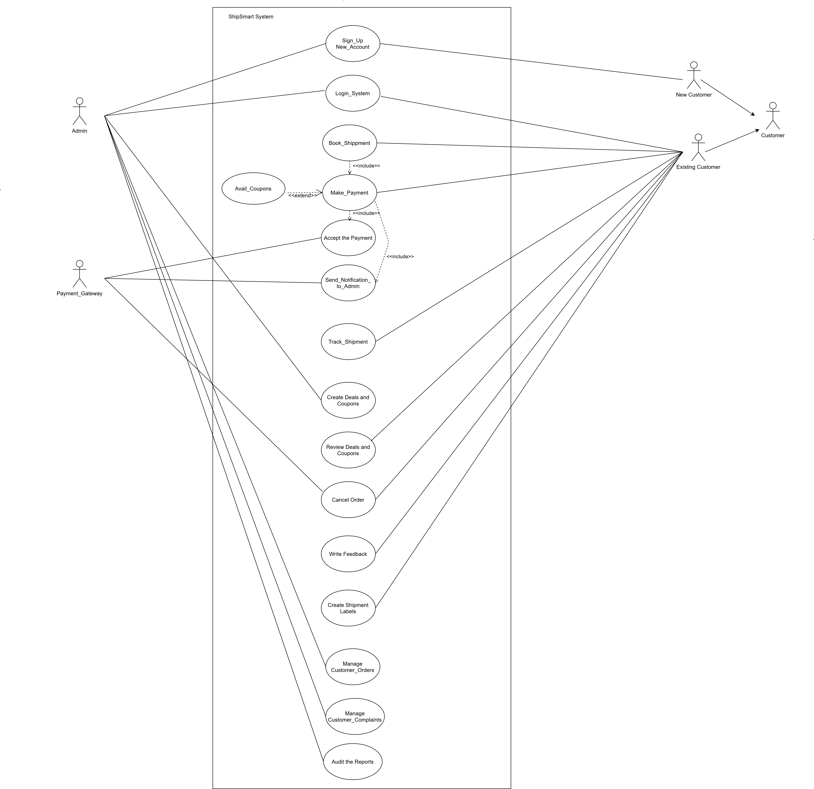
Use Case Diagram
dd

Slide 7
Non Functional Requirements
Availability
ShipSmart is available at any given day and time
Security
All payments gateways are deployed in secure channels.
Passwords in database will be encrypted.
Compatability
Shipsmart works on desktops, tables and smartphones that operate on android, windows and ios.
It operates without omitting any of the system’s pages component.
dd
Pages Loading time
All pages load quickly
Sharing On Social media
Share on FB/Twitter/Instagram

Slide 8
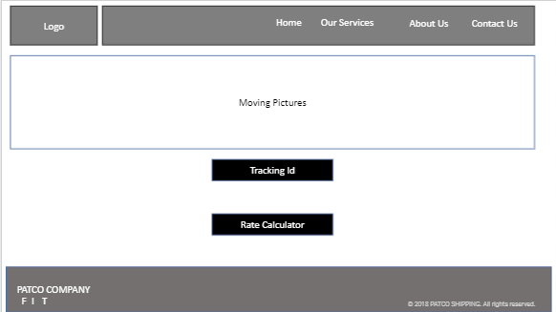
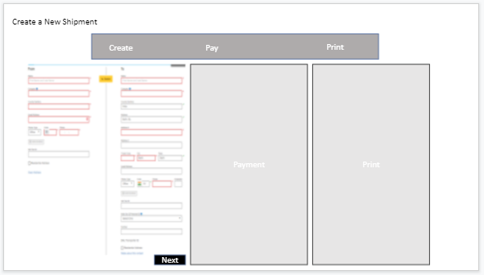
Design 1
Low Fidelity Prototyping
dd

Slide 9
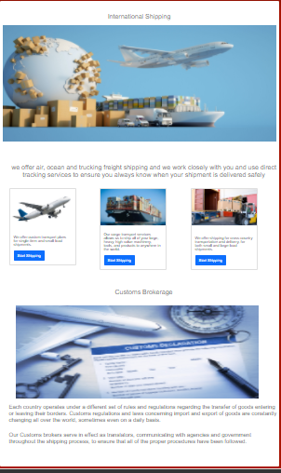
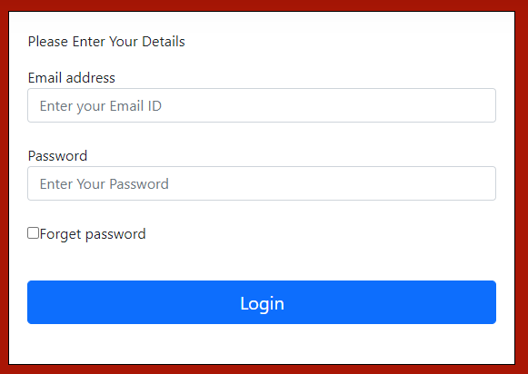
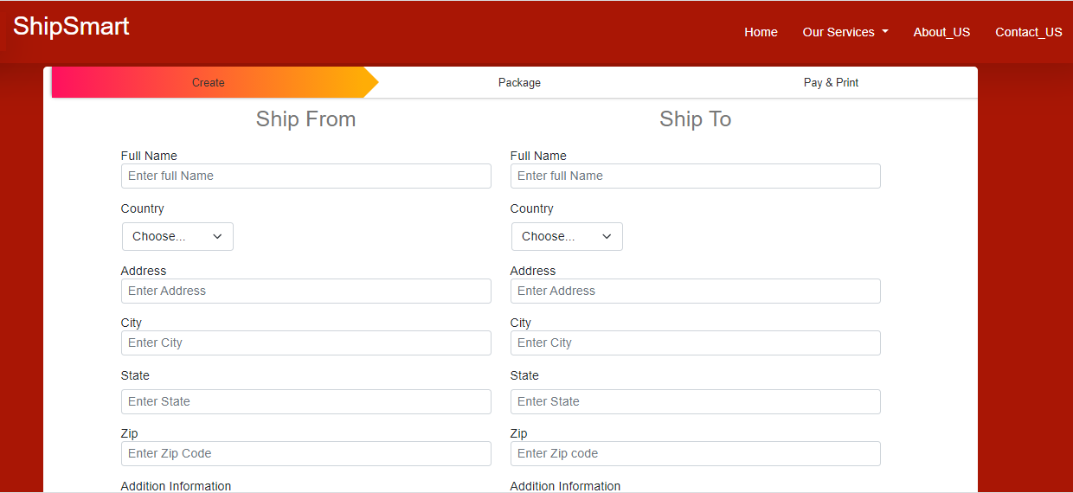
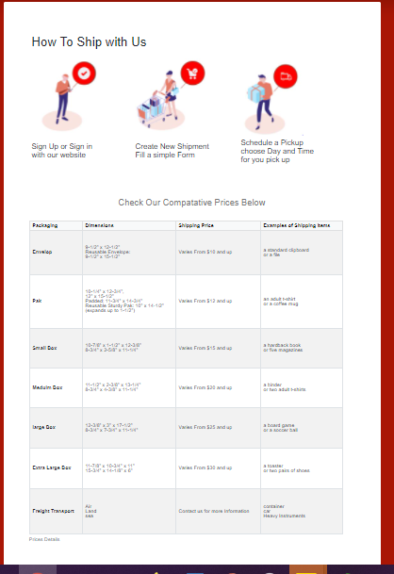
Design 2
UI/ UX Design
Bootstrap 5 CSS3
dd

Slide 10
General Design Approach
Front End
Admin Dashboard
Customer’s View
ShipSmart
Through ShipSmart System
Database
Admins and Customers have different Privileges
dd

Slide 11
Class Diagram
User
Customer
-
firstName: string
-
lastName: string
Admin
-
address:string
-
emailId: string
-
employeeId: string
1
-
phone: int
-
password:string
-
adminEmail: string
-
payment info: string
-
signUpDate: date
-
shippingInfo: string
-
loginStatus:string
+
updateOffers
+
()
auditReport
+
register
()
()
+
createComplains
+
login
+
verifyLogin(): bool
()
+
()
updateProfile
.
()
dd
0..*
Track Shippment
1
Book Shippment
-
trackingId: int
-
addressFrom: string
-
addressTo: string
+
viewShippingStatus()
-
pickupDate: date
0..*
-
pickupTime: time
,
-
packageDeatils:string
1
-
packageWeight: int
+
bookShippment
+
()
selectDeliveryoption
+
checkOut
()
1
+
()
printLabel
+
()
1
cancelShippment
Shipping Info
()
1
Payment Info
-
shippingId: int
-
shippingId: int
-
shippingCost:int
-
shippingOption:string
-
shippingfrom:string
1
-
weight:int
-
shippingTo:string
-
totalCost:float
+
updateShippingInfo
1
()
+
calcprice
+
()
verifyPayment
()

Slide 12
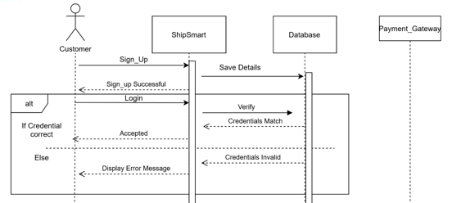
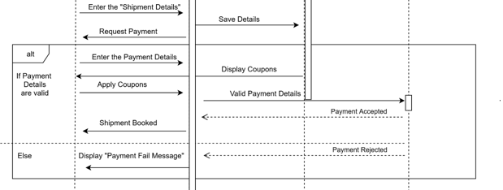
Sequence Diagram
Customer Sign Up/ Login
dd
Proceed Payment

Slide 13
Implementation
Website Pages
Control
Data Base
dd

Slide 14
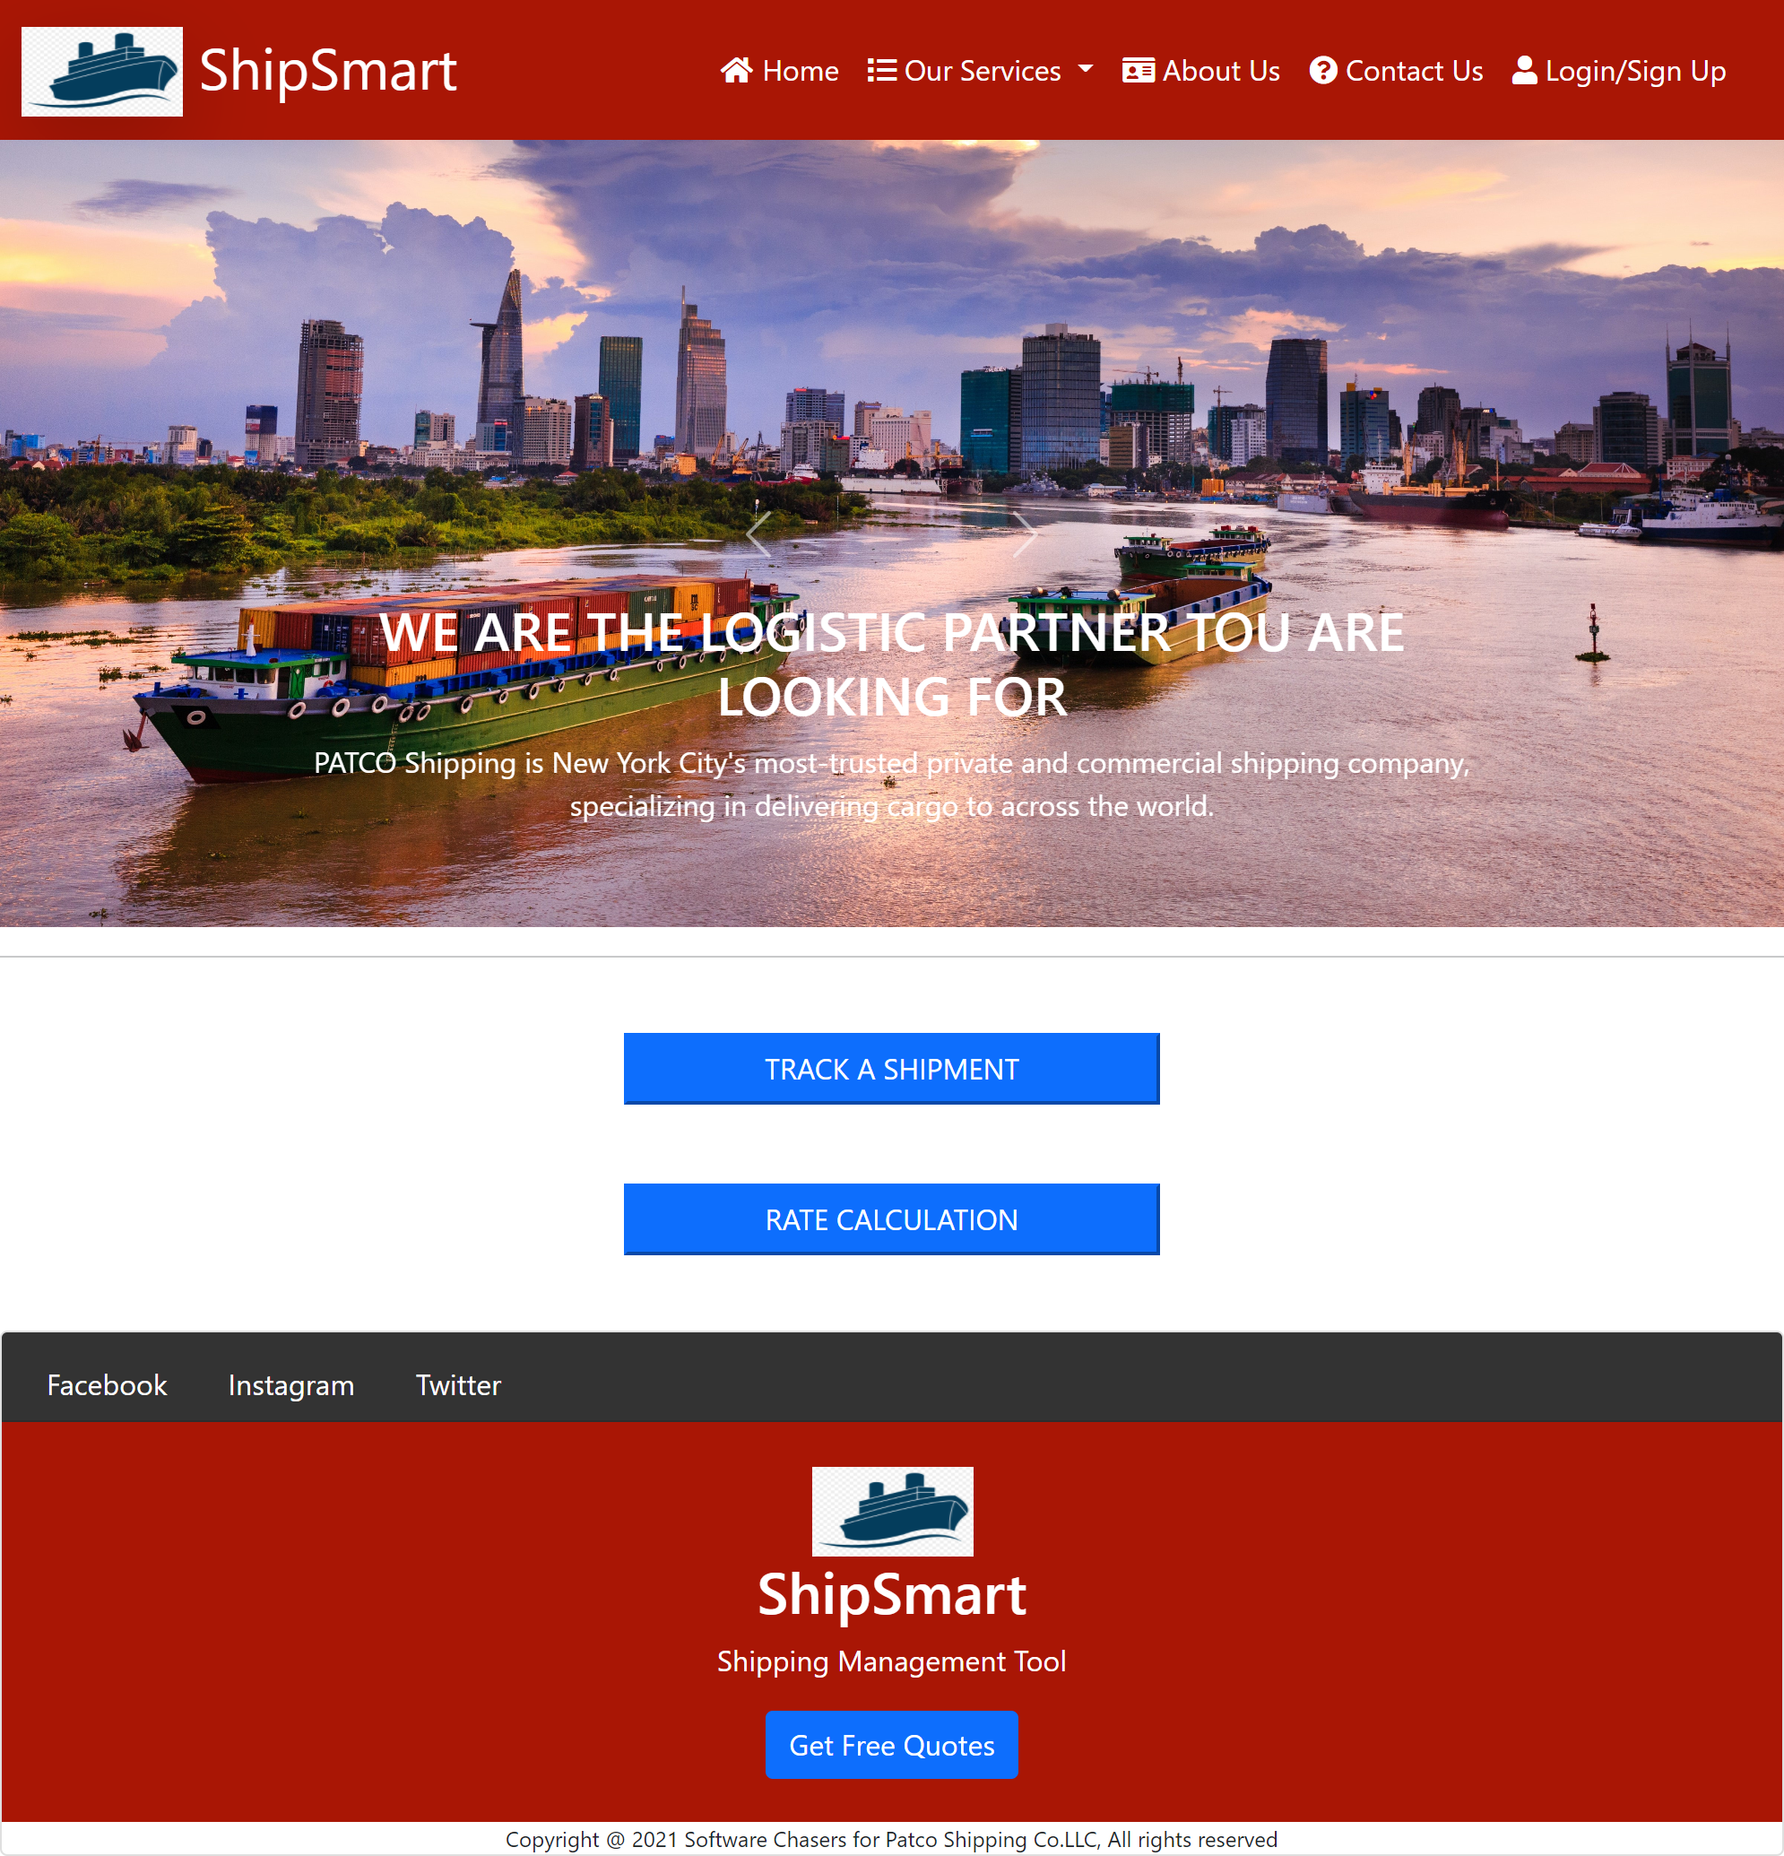
Home Page
dd
From Home Page ShipSmart users can access different services for both admins and general users

Slide 15
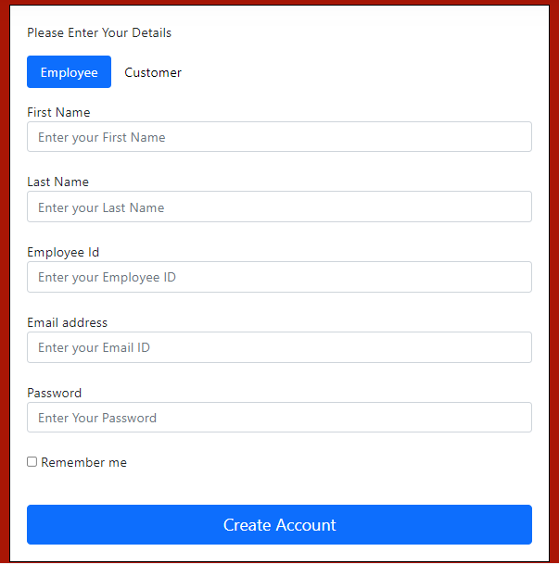
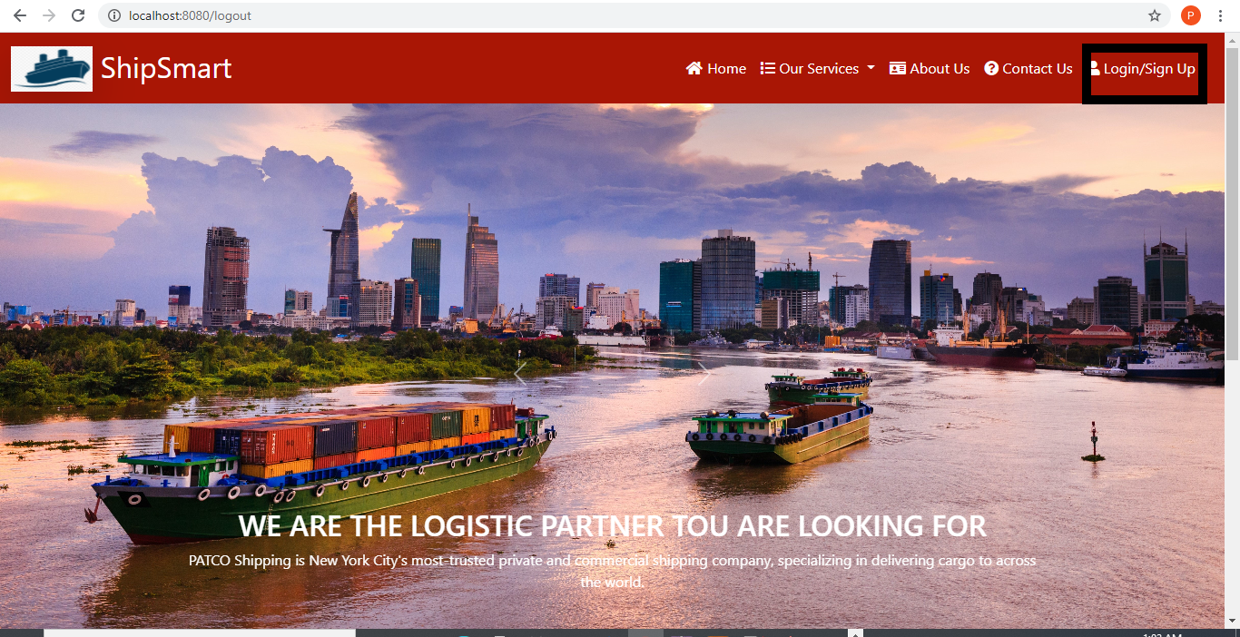
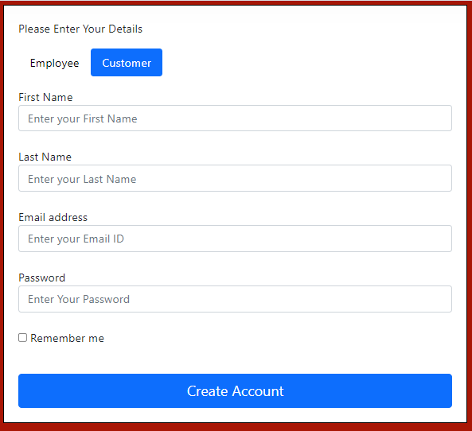
Sign Up
dd
Admin / Employee Sign Up
Needs to provide Employee ID
General User/ Customer Sign Up

Slide 16
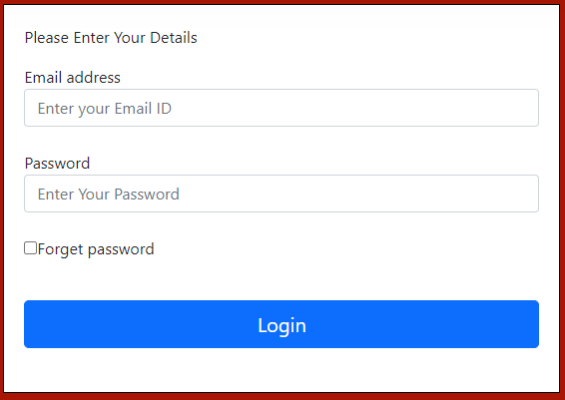
Log In
dd
Admins / General Users Log in Form
Admins will have access to admin dashboard
General users have access to general functions in home page

Slide 17
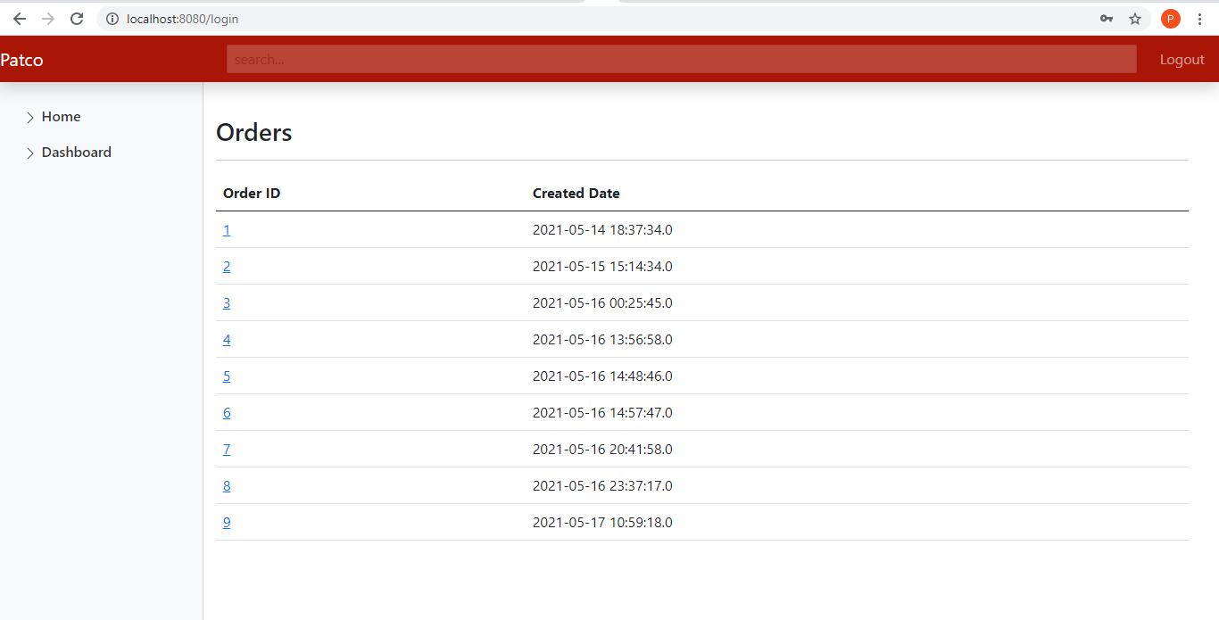
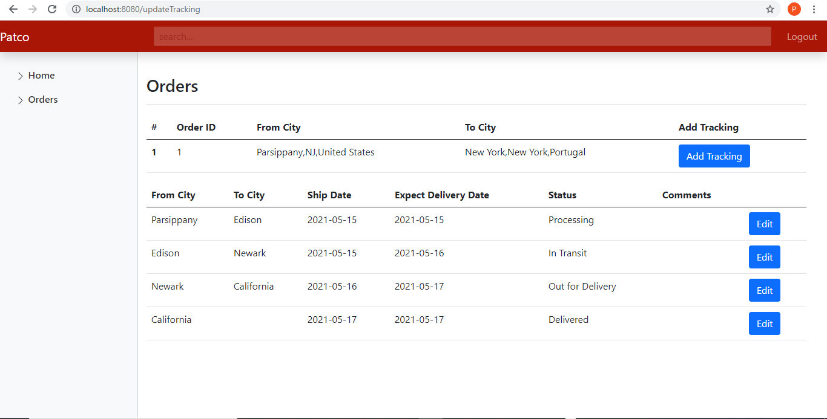
Admin Dashboard
ShipSmart Admins/ Patco Employees
Review Orders History From admin dashboard
dd
ShipSmart Admins/ Patco Employees
Manage orders and Edit Orders Status

Slide 18
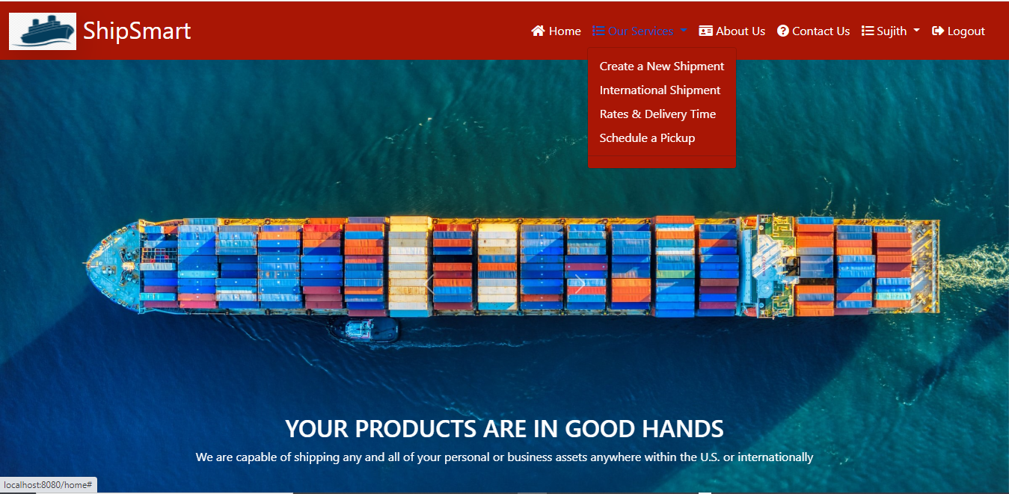
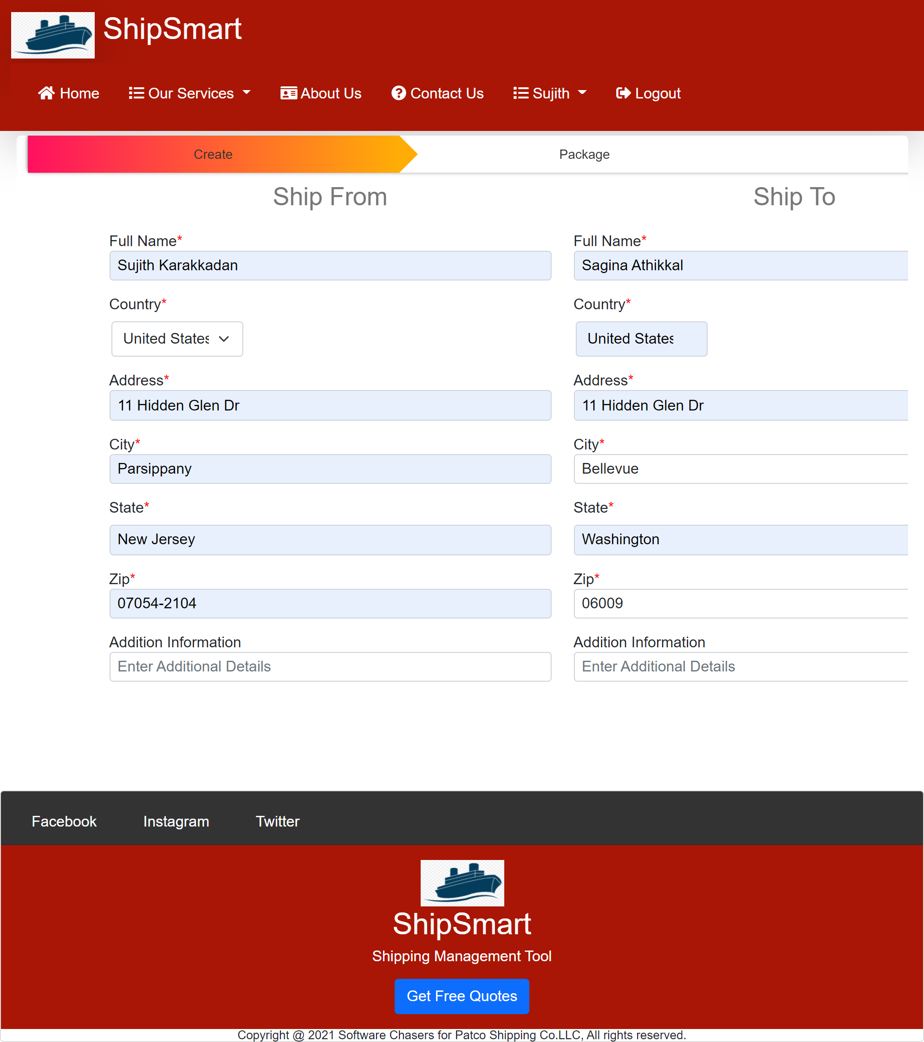
Create New Shipment 1
dd
Create New Shipment Form

Slide 19
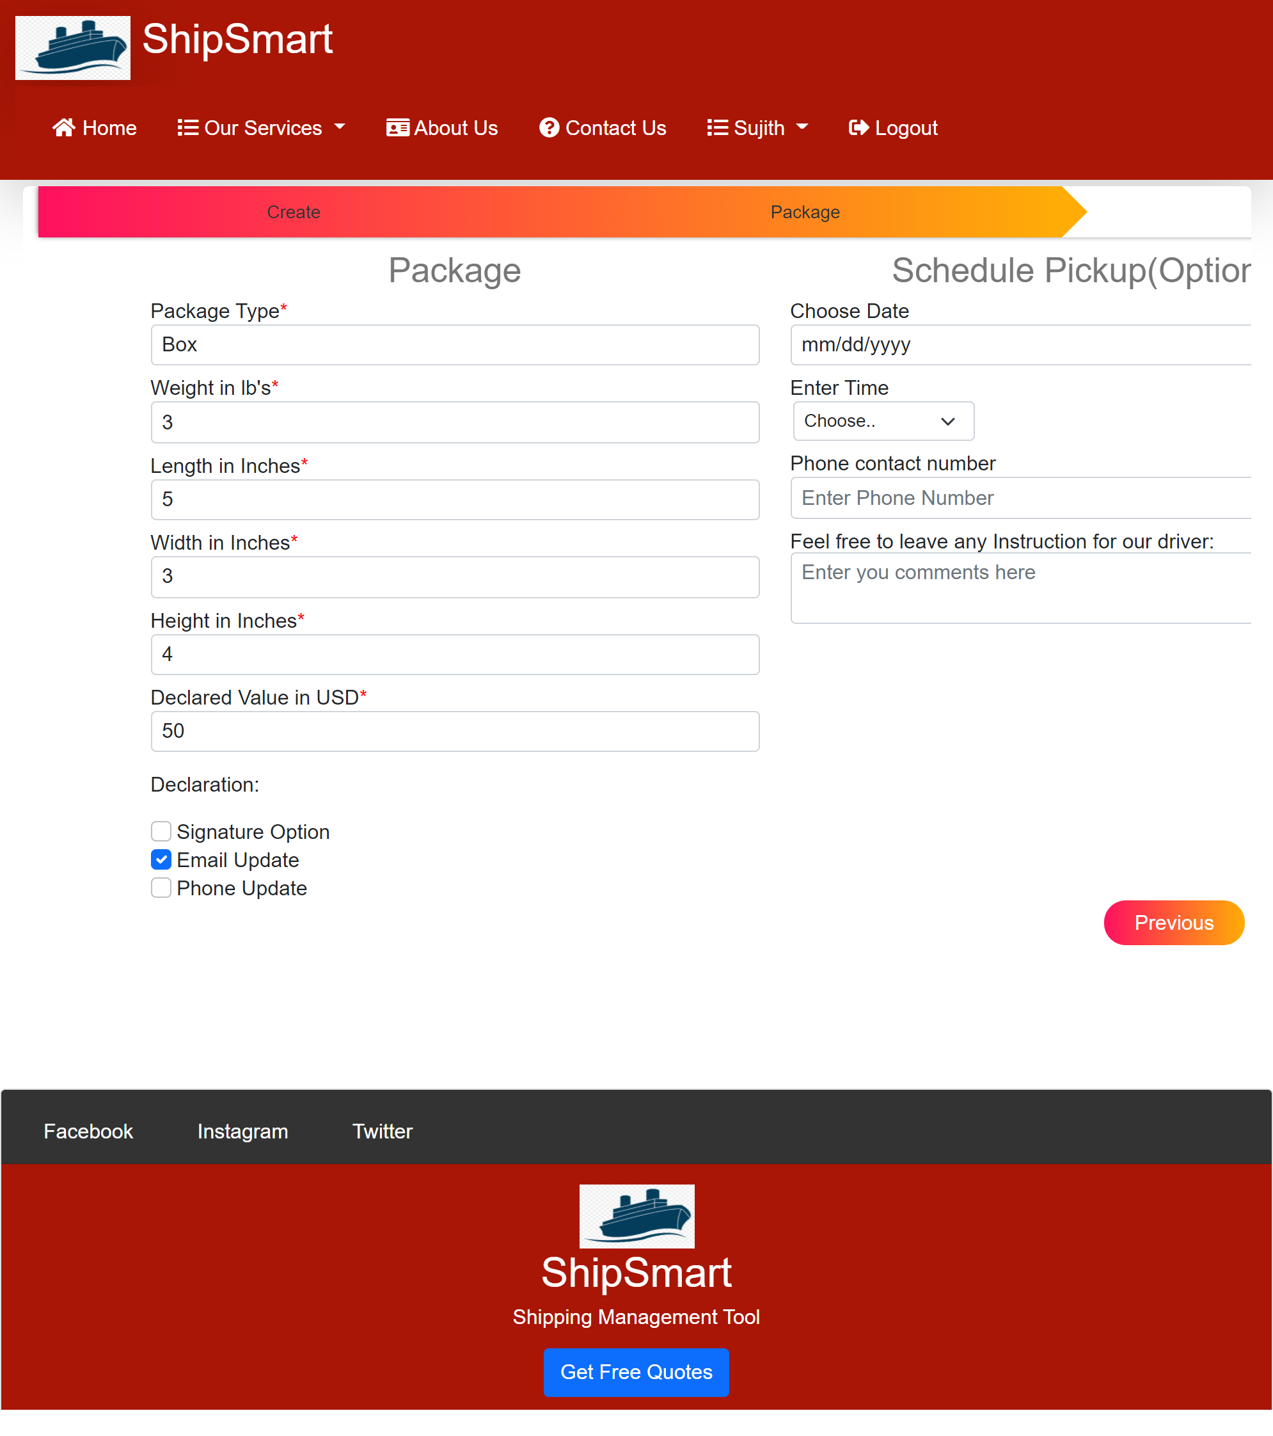
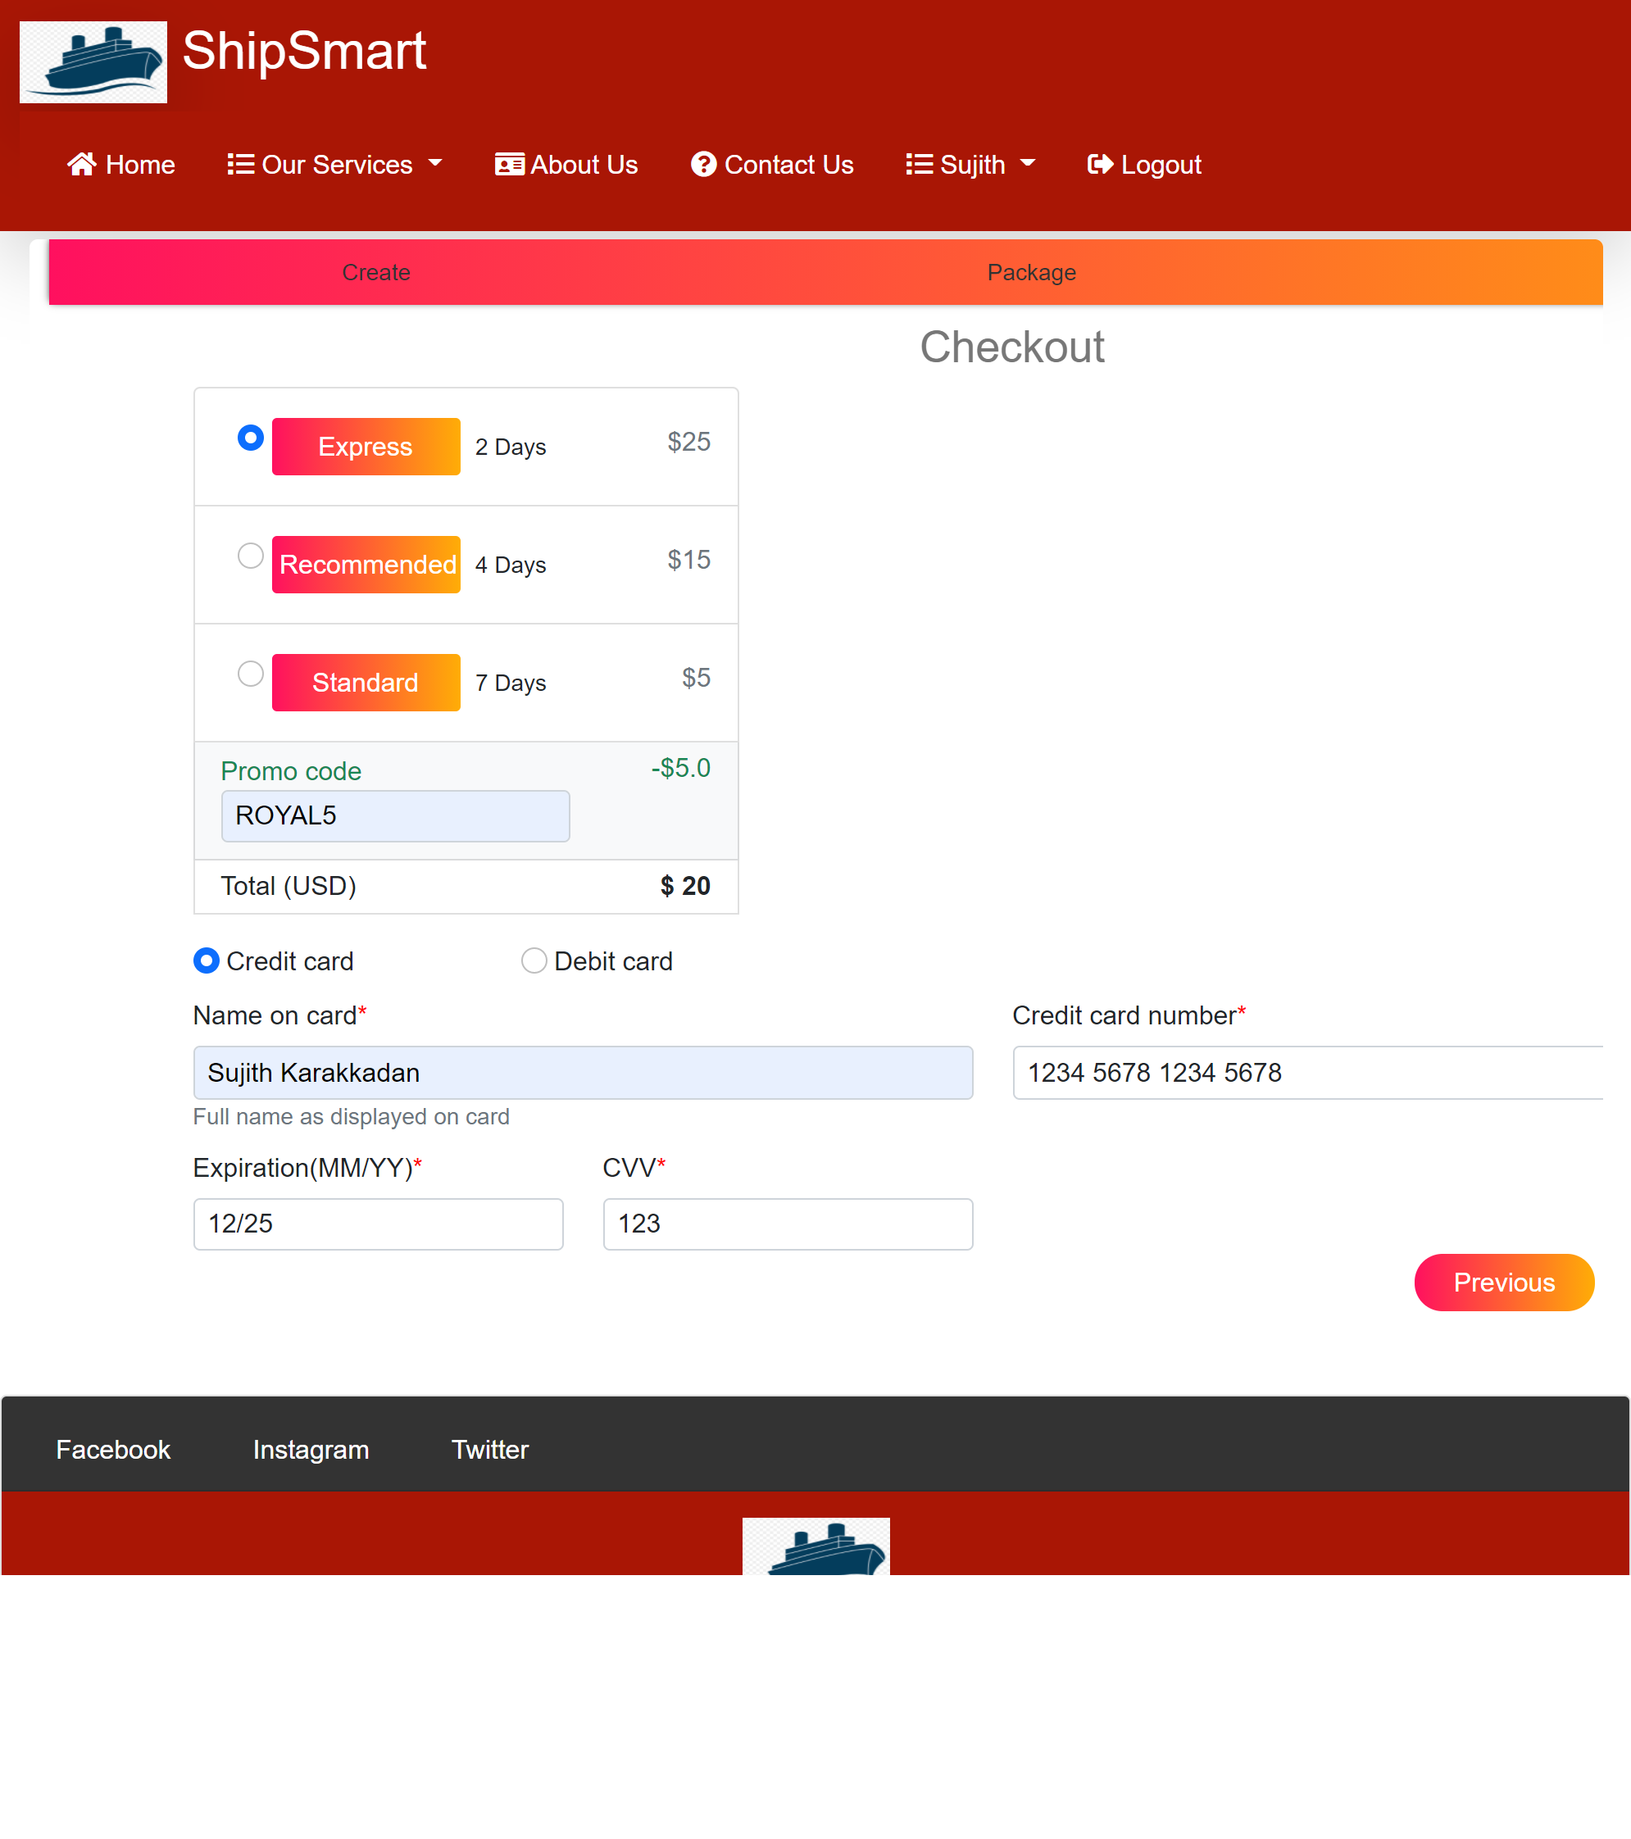
Create New Shipment 2
User Has to enter Package details and Schedule a pickup time
dd
Choose Express, Recommended, Slandered shipping methods
Apply promo code to get more discount

Slide 20
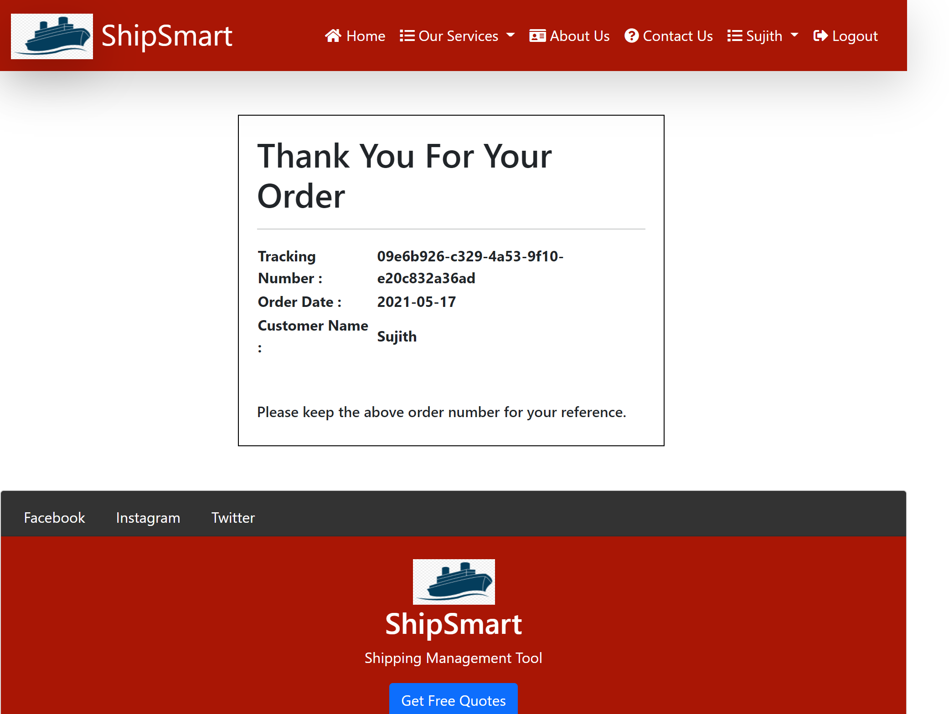
Shipment Confirmation
dd
A receipt will be available for customer once he is done with check out
This receipt includes the tracking number, order date, customer name

Slide 21
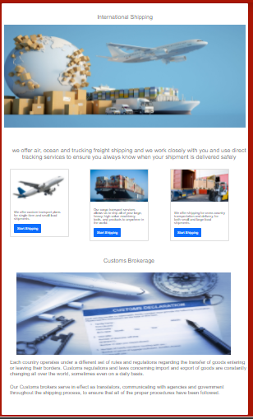
International Shipping
dd
General User/ Customer
Can explore Different Options for international/ Cross borders Shipping

Slide 22
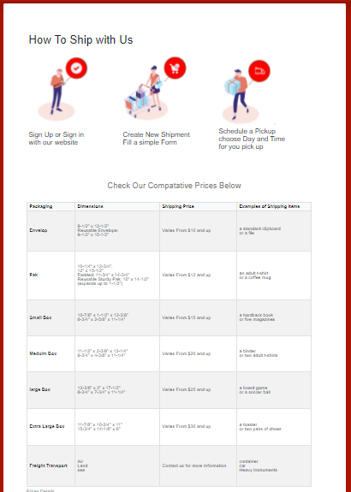
Rates and Prices
dd
General User/ Customer
Get General Idea how to ship with ShipSmart Software
Explore estimated prices for different packages sizes

Slide 23
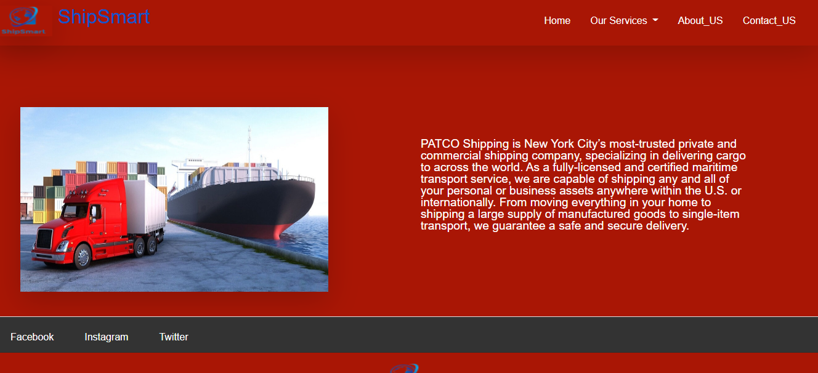
About Us
dd
General User/ Customer
Get general idea about Patco services

Slide 24
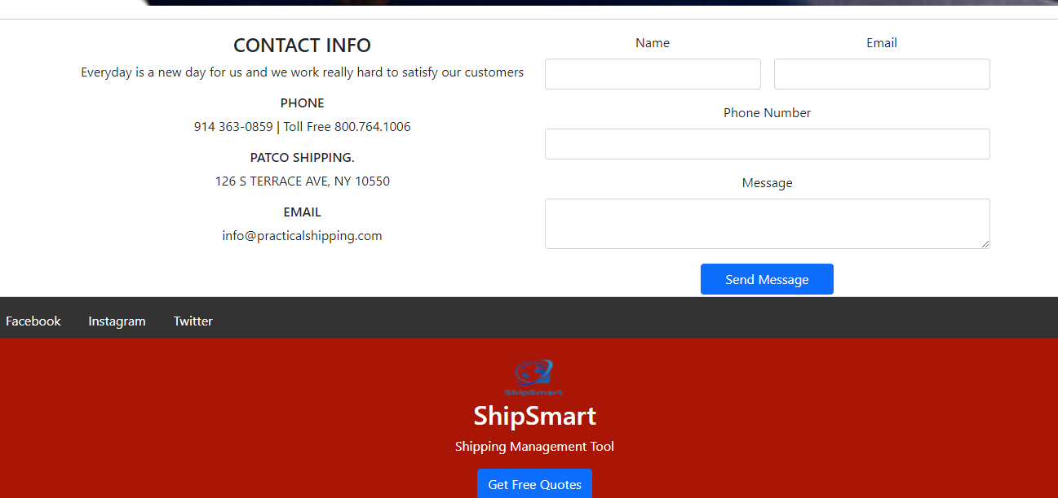
Contact Us
dd
General User/ Customer
Explores Patco Contacting Infos
Can leave a message for Patco Employee so the employee can reach out with him later

Slide 25
Testing Approach
Black box testing
White box testing
End-to-end testing
Unit testing
Integration testing
Regression testing
dd
Performs By
Software Chasers Team Members

Slide 26
Success Criteria
All high and medium priority modules must be tested and fixed if there are any bugs located. Also, it must be retested after fixing the bugs by using regression testing.
System functionalities and Modules must be validated and traced back to the specified requirements listed in the SRS and Design documents.
The integration of modules must be tested to ensure that all modules collaborate appropriately, and any located bugs must be fixed.
dd

Slide 27
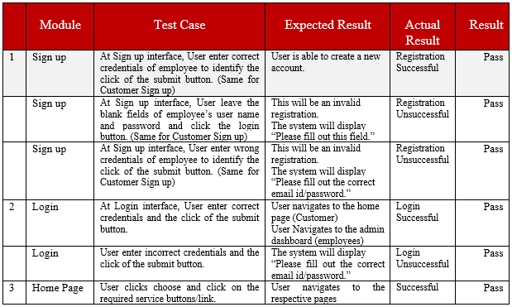
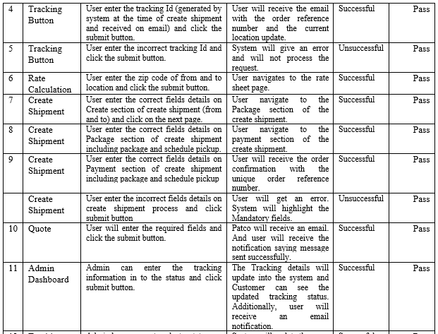
Test Cases
dd

Slide 28
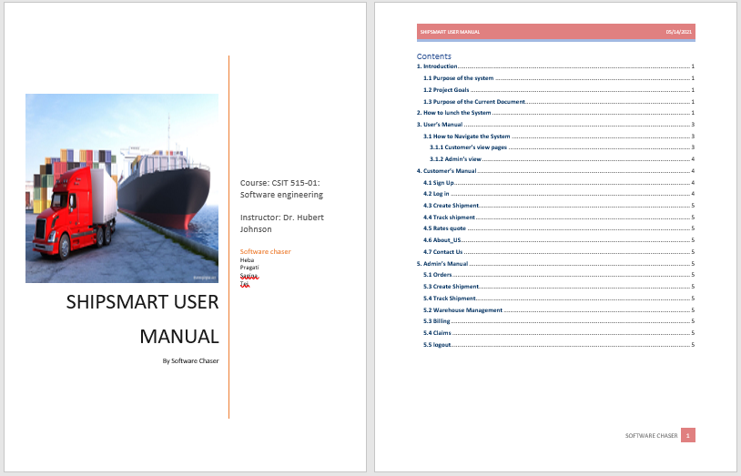
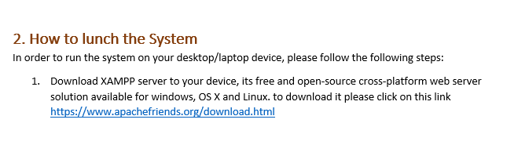
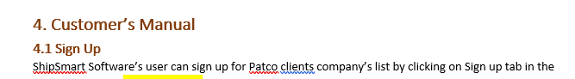
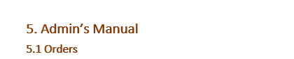
User Manual
dd

Slide 29
Requirements
Thank You
dd

